Slide 1
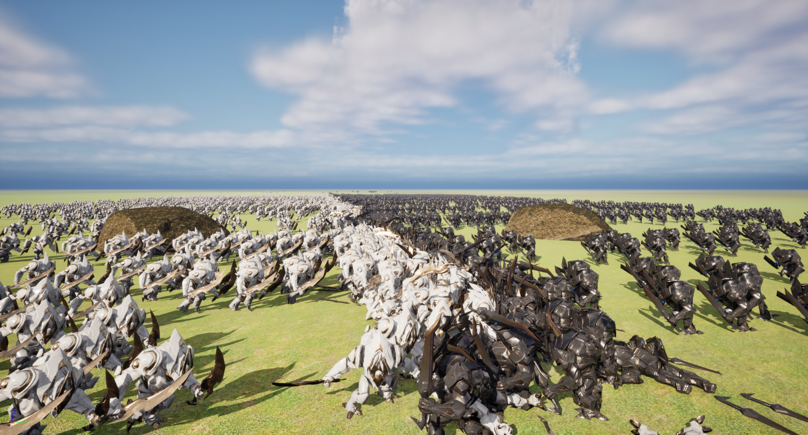
Simulating massive amounts of AI agents in video games
Simon Schaep
Notes:
I am simon
GD student
Gameplay programmer
Research will be about …

Slide 2
Demo Showcase
Notes:
Before getting into details, show what I achieved

Slide 3
Research Question
How to simulate massive amounts of independent AI agents in real-time, in a 3D game made with a modern game engine?
Notes:
Research many different ways to optimize
Lot of time went into data oriented programming
Interesting approach
Separate code from data
Align data for max cpu cache usage
Multithreading, obvious, but did some research on how to use in UE5
Spatial partitioning, seems to be the first thing most people recommend online
Animations, also found Niagara rendering smart particles interesting
Gpu programming was used in UEBS2

Slide 4
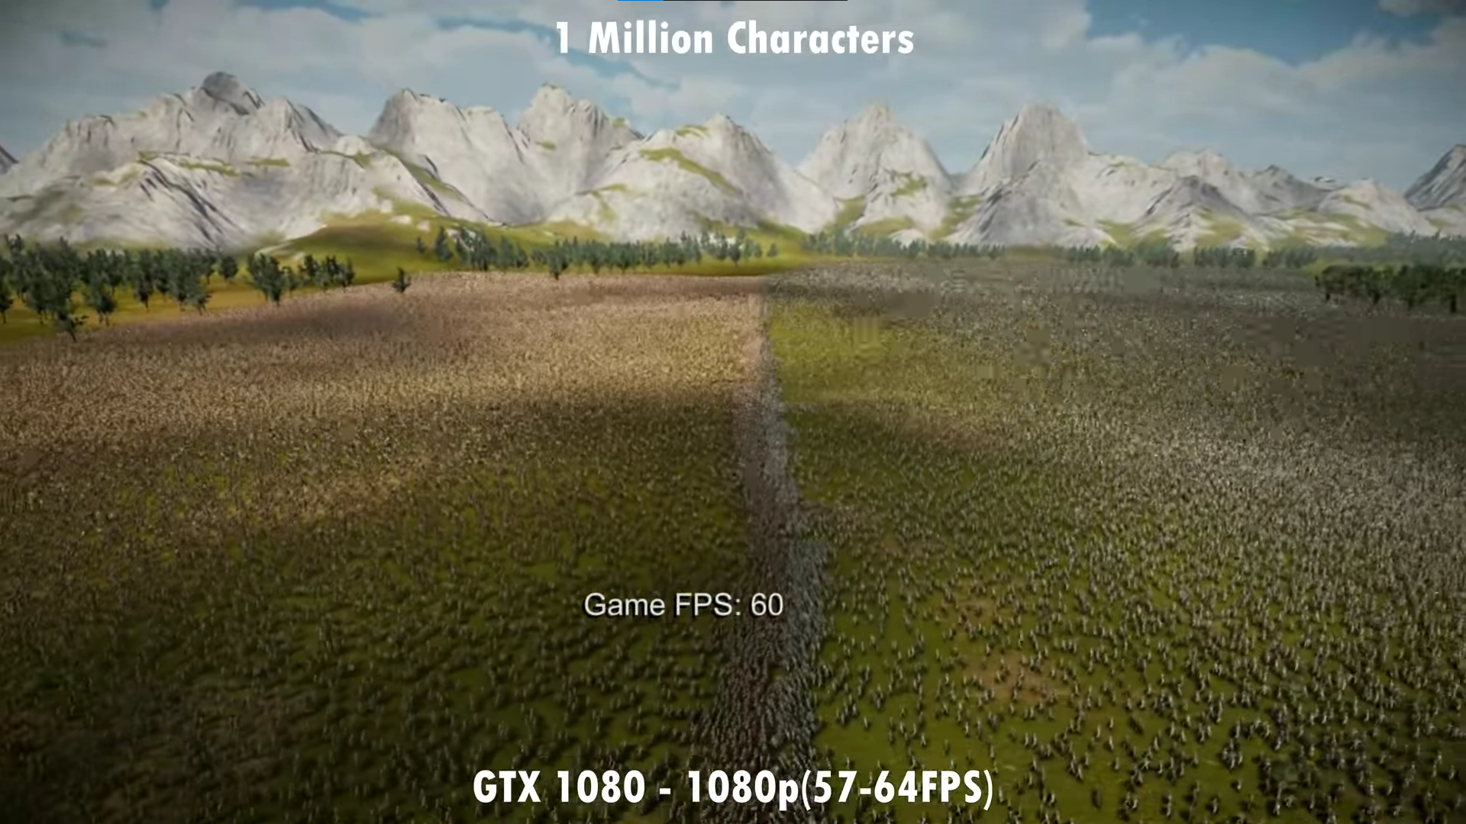
Literature Study
How to optimize?
Data Oriented Programming
Mass
Multithreading
Spatial partitioning
Animations
GPU programming
Ultimate Epic Battle Simulator 2 – The making of Pt1
Notes:
Research many different ways to optimize
Lot of time went into data oriented programming
Interesting approach
Separate code from data
Align data for max cpu cache usage
ECS is how usually implemented, explain shortly
Mass, Unreal way for DOP, uses ECS approach, but changes some naming, explain shortly
Multithreading, obvious, but did some research on how to use in UE5
Spatial partitioning, seems to be the first thing most people recommend online
Animations, also found Niagara rendering smart particles interesting
Gpu programming was used in UEBS2

Slide 5
Case study
By utilizing Unreal Engine’s Mass system, combined with other techniques, we can simulate more than 20 000 agents fighting each other at 30 fps.
Notes:
Case study
Hypothesis
We are going to test different agent counts, each time doubling, to find how it scales

Slide 6
Case study
Requirements:
Two teams
Units find/attack closest target
Avoidance & Pathfinding
3D animated models
Notes:
Requirements important

Slide 7
Experiment
Simple battle simulator
Mass
Multithreading
Spatial partitioning
Animation sharing
Notes:
Cant go too much into detail
Simple: unitmanager, components
Mass: explain processor definition
Multithreading: Most important for nav and target, parallel for works perfectly
Spatial: Very good for target finding, using TOctree2
Anim sharing: ideally would have tried vertex anim, but not enough time, and this turned out very good

Slide 8
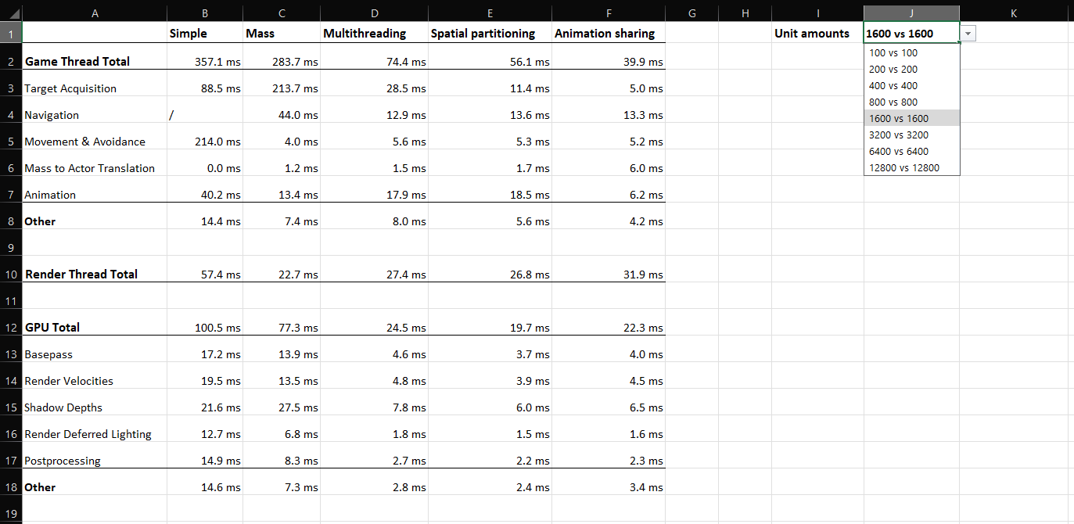
Results
Notes:
Tested all scenarios, took frame at 10 seconds (prepare why for final)
Combined in this sheet, with handy dropdown

Slide 10
Conclusion
Game thread is the primary bottleneck
Spatial partitioning is very important
Data oriented programming has potential

Slide 11
Questions?

